Slide 1

CSCI/ARTI 8950 Machine Learning
Lecture Notes 13: Ensemble Learning, Data Transformations
Khaled Rasheed
Professor
School of Computing
Member
Institute for Artificial Intelligence
University of Georgia
Source: Data Mining by I. H. Witten, E. Frank, M. A. Hall and C. J. Pal

Slide 2
Ensemble learning
Topics
Combining multiple models
The basic idea
Bagging
Bias-variance decomposition, bagging with costs
Boosting
AdaBoost, the power of boosting
Stacking

Slide 3
Combining multiple models
Basic idea: build different “experts”, let them vote
Advantage:
often improves predictive performance
Disadvantage:
usually produces output that is very hard to analyze
but: there are approaches that aim to produce a single comprehensible structure

Slide 4
Bagging
Combining predictions by voting/averaging
Each model receives equal weight
“Idealized” version:
Sample several training sets of size n (instead of just having one training set of size n)
Build a classifier for each training set
Combine the classifiers’ predictions
Learning scheme is unstable → almost always improves performance
Unstable learner: small change in training data can make big change in model (e.g., when learning decision trees)

Slide 5
Bias-variance decomposition
The bias-variance decomposition is used to analyze how much restriction to a single training set affects performance
Assume we have the idealized ensemble classifier discussed on the previous slide
We can decompose the expected error of any individual ensemble member as follows:
Bias = expected error of the ensemble classifier on new data
Variance = component of the expected error due to the particular training set being used to built our classifier
Total expected error = bias + variance
Note (A): we assume noise inherent in the data is part of the bias component as it cannot normally be measured
Note (B): multiple versions of this decomposition exist for zero-one loss but the basic idea is always the same

Slide 6
More on bagging
The idealized version of bagging improves performance because it eliminates the variance component of the error
Note: The bias-variance decomposition was originally only known for numeric prediction with squared error where the error never increases
Problem: we only have one dataset!
Solution: generate new datasets of size n by sampling from the original dataset with replacement
This is what bagging does and even though the datasets are all dependent, bagging often reduces variance, and, thus, error
Can be applied to numeric prediction and classification
Can help a lot if the data is noisy
Usually, the more classifiers the better, with diminishing returns

Slide 7
Bagging classifiers
Model generation
Let n be the number of instances in the training data
For each of t iterations:
Sample n instances from training set
(with replacement)
Apply learning algorithm to the sample
Store resulting model
Classification
For each of the t models:
Predict class of instance using model
Return class that is predicted most often

Slide 8
Boosting
Bagging can easily be parallelized because ensemble members are created independently
Boosting is an alternative approach
Also uses voting/averaging
But: weights models according to performance
Iterative: new models are influenced by performance of previously built ones
Encourage new model to become an “expert” for instances misclassified by earlier models
Intuitive justification: models should be experts that complement each other
Many variants of boosting exist, we cover one

Slide 9
Boosting using AdaBoost.M1
Model generation
Assign equal weight to each training instance
For t iterations:
Apply learning algorithm to weighted dataset,
store resulting model
Compute model’s error e on weighted dataset
If e = 0 or e ≥ 0.5:
Terminate model generation
For each instance in dataset:
If classified correctly by model:
Multiply instance’s weight by e/(1-e)
Normalize weight of all instances
Classification
Assign weight = 0 to all classes
For each of the t (or less) models:
For the class this model predicts
add –log e/(1-e) to this class’s weight
Return class with highest weight

Slide 10
Comments on AdaBoost.M1
Boosting needs weights … but
can adapt learning algorithm ... or
can apply boosting without weights:
Resample data with probability determined by weights
Disadvantage: not all instances are used
Advantage: if error > 0.5, can resample again
The AdaBoost.M1 boosting algorithm stems from work in computational learning theory
Theoretical result:
Training error decreases exponentially as iterations are performed
Other theoretical results:
Works well if base classifiers are not too complex and
their error does not become too large too quickly as more iterations are performed

Slide 11
More comments on boosting
Continue boosting after training error = 0?
Puzzling fact: generalization error continues to decrease!
Seems to contradict Occam’s Razor
Possible explanation: consider margin (confidence), not just error
A possible definition of margin: difference between estimated probability for true class and nearest other class (between –1 and 1)
Margin continues to increase with more iterations
AdaBoost.M1 works well with so-called weak learners; only condition: error does not exceed 0.5
Example of weak learner: decision stump
In practice, boosting sometimes overfits if too many iterations are performed (in contrast to bagging)

Slide 12
Stacking
Question: how to build a heterogeneous ensemble consisting of different types of models (e.g., decision tree and neural network)
Problem: models can be vastly different in accuracy
Idea: to combine predictions of base learners, do not just vote, instead, use meta learner
In stacking, the base learners are also called level-0 models
Meta learner is called level-1 model
Predictions of base learners are input to meta learner
Base learners are usually different learning schemes
Caveat: cannot use predictions on training data to generate data for level-1 model!
Instead use scheme based on cross-validation

Slide 13
Generating the level-1 training data
Training data for level-1 model contains predictions of level-0 models as attributes; class attribute remains the same
Problem: we cannot use the level-0 models predictions on their training data to obtain attribute values for the level-1 data
Assume we have a perfect rote learner as one of the level-0 learner
Then, the level-1 learner will learn to simply predict this level-0’s learners predictions, rendering the ensemble pointless
To solve this, we generate the level-1 training data by running a cross-validation for each of the level-0 algorithms
Then, the predictions (and actual class values) obtained for the test instances encountered during the cross-validation are collected
This pooled data obtained from the cross-validation for each level-0 model is used to train the level-1 model

Slide 14
More on stacking
Stacking is hard to analyze theoretically: “black magic”
If the base learners can output class probabilities, use those as input to meta learner instead of plain classifications
Makes more information available to the level-1 learner
Important question: which algorithm to use as the meta learner (aka level-1 learner)?
In principle, any learning scheme
In practice, prefer “relatively global, smooth” models because
base learners do most of the work and
this reduces the risk of overfitting
Note that stacking can be trivially applied to numeric prediction too

Slide 15
Data transformations
Topics
Feature (Attribute) selection: Scheme-independent and scheme-specific
Feature extraction (Projections): principal component analysis (PCA), independent component analysis (ICA)
Notes:
7/27/2026
15
15

Slide 16
Attribute selection
Attribute selection is often important in practice
For example, adding a random (i.e., irrelevant) attribute can significantly degrade C4.5’s performance
Problem: C4.5’s built-in attribute selection is based on smaller and smaller amounts of data
Instance-based learning is particularly susceptible to irrelevant attributes
Number of training instances required increases exponentially with number of irrelevant attributes
Exception: naïve Bayes can cope well with irrelevant attributes
Notes:
7/27/2026
16
16

Slide 17
Scheme-independent attribute selection
Filter approach to attribute selection: assess attributes based on general characteristics of the data
In this approach, the attributes are selected in a manner that is independent of the target machine learning scheme
One method: find smallest subset of attributes that separates data
Another method: use a fast learning scheme that is different from the target learning scheme to find relevant attributes
E.g., use attributes selected by decision tree (classification), or attributes with large coefficients of linear model (regression)
Notes:
7/27/2026
17
17

Slide 18
Scheme-independent attribute selection
Attribute weighting techniques based on statistical measures can also be used for filtering
Information Gain, Gain ratio, … etc.
Problem: cannot identify redundant attributes
Correlation-based Feature Selection (CFS): Finds a subset of attributes such that:
Correlation between attributes in the subset is low
Correlation between each attribute in the subset and the target attribute is high
Problem: number of possible subsets is very large
Notes:
7/27/2026
18
18

Slide 19
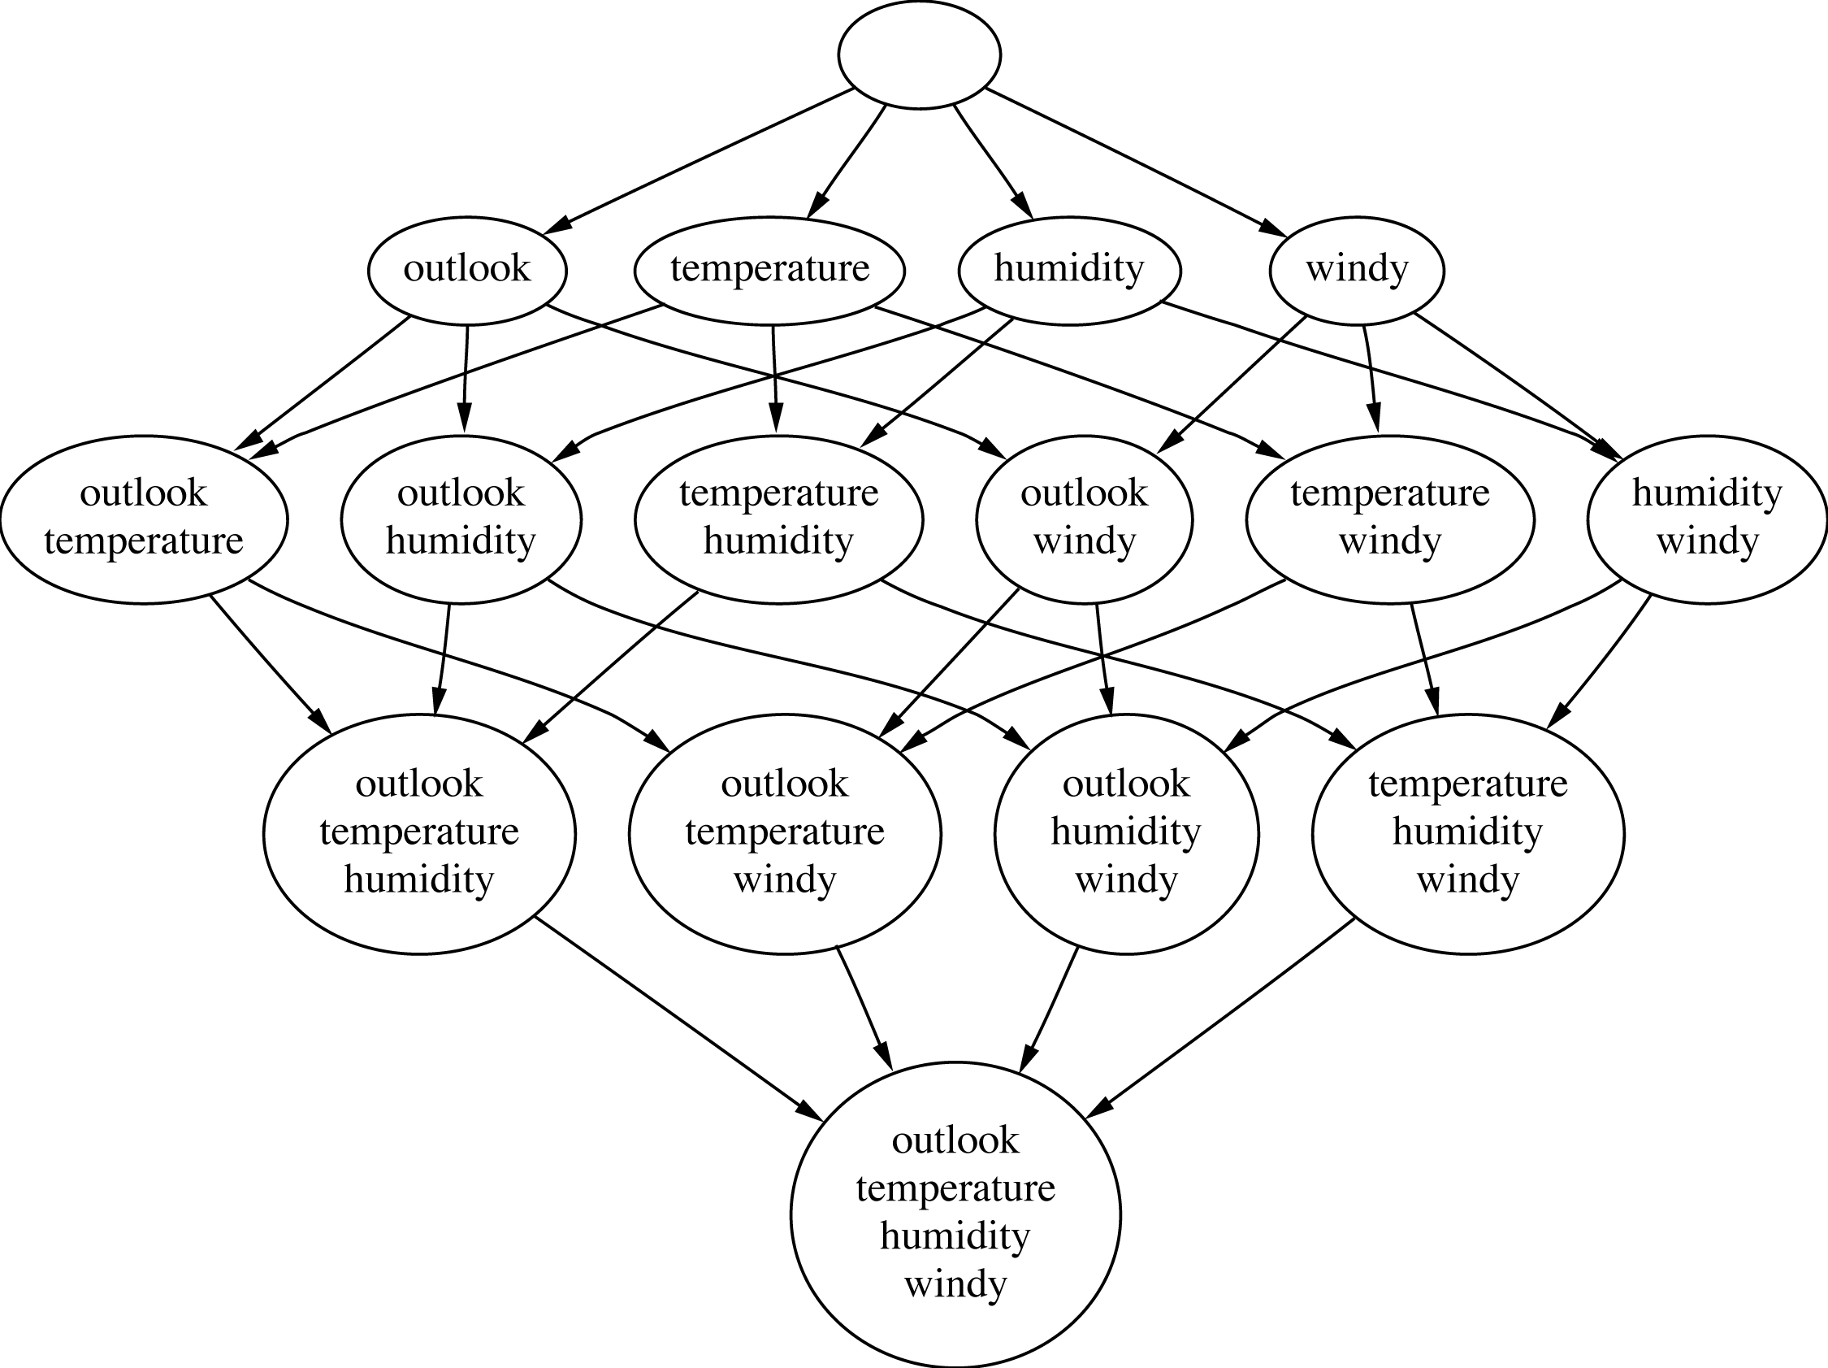
Attribute subsets for weather data
Notes:
7/27/2026
19
19

Slide 20
Searching the attribute space
Number of attribute subsets is exponential in the number of attributes
Common greedy approaches:
forward selection
backward elimination
More sophisticated strategies:
Bidirectional search
Best-first search: can find optimum solution
Beam search: approximation to best-first search
Genetic algorithms
Notes:
7/27/2026
20
20

Slide 21
Scheme-specific selection
Wrapper approach to attribute selection: attributes are selected with target scheme in the loop
Implement “wrapper” around learning scheme
Evaluation criterion: cross-validation performance
Extremely time consuming in general
Notes:
7/27/2026
21
21

Slide 22
Projections
Simple transformations can often make a large difference in performance
Example transformations (not necessarily for performance improvement):
Difference of two date attributes
Ratio of two numeric (ratio-scale) attributes
Concatenating the values of nominal attributes
Adding noise to data
Removing data randomly or selectively
Notes:
7/27/2026
22
22

Slide 23
Principal component analysis
Unsupervised method for identifying the important directions in a dataset
We can then rotate the data into the (reduced) coordinate system that is given by those directions
PCA is a method for dimensionality reduction
Algorithm:
Find direction (axis) of greatest variance
Find direction of greatest variance that is perpendicular to previous direction and repeat
Implementation: find eigenvectors of the covariance matrix of the data
Eigenvectors (sorted by eigenvalues) are the directions
Notes:
7/27/2026
23
23

Slide 24
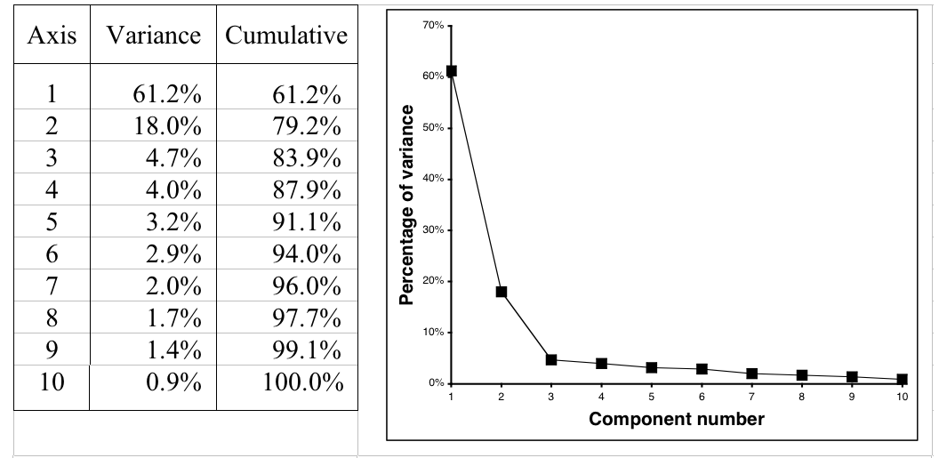
Example: 10-dimensional data
Data is normally standardized or mean-centered for PCA
Usually a few top components will be sufficient to represent the original data
Notes:
7/27/2026
24
24

Slide 25
Independent component analysis (ICA)
PCA finds a coordinate system for a feature space that captures the covariance of the data
In contrast, ICA seeks a projection that decomposes the data into sources that are statistically independent
Consider the “cocktail party problem,” where people hear music and the voices of other people: the goal is to un-mix these signals
ICA finds a linear projection of the mixed signal that gives the most statistically independent set of transformed variables

